Slide 1



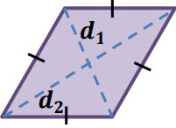
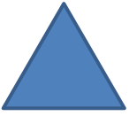








Area and Volume 1
Area of different shape
2
l
Area of square
$$=$$
l
h
Area of parallelogram
$$=$$
bh
l
b
w
Area of rectangle
$$=$$
lw
d
d
Area of rhombus
$$=$$
1
2
2
l
b
1
bh
b
$$+$$
b
Area of triangle
1
2
h
$$=$$
h
Area of trapezium
$$=$$
2
2
b
b
2

Slide 2

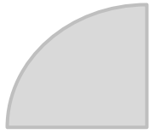
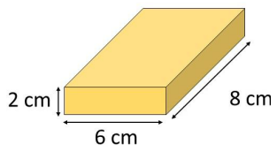
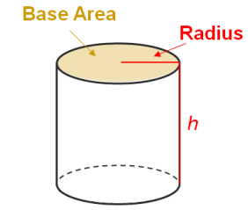











r
2
2
$$θ$$
$$=$$
$$π$$
r
$$=$$
$$π$$
Area of circle
Area of Sector
r
$$×$$
360
$$θ$$
r
Volume of Prism
Volume of Prism
$$=$$
base area
$$×$$
h
$$=$$
$$π$$
2
Volume of cylinder
r
h

Slide 3
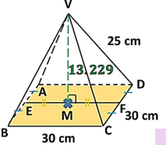

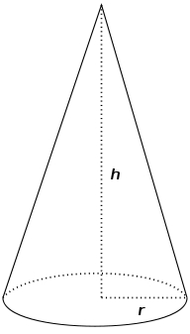






Volume of Pyramid
1
Volume of Pyramid
$$=$$
$$×$$
base area
$$×$$
h
3
1
2
Volume of Cone
$$=$$
$$×$$
$$π$$
r
h
3

Slide 4
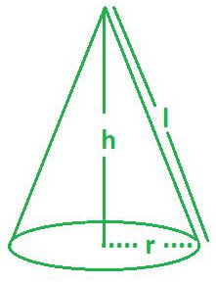
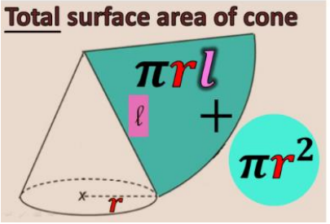








Surface area of cone
Curved surface area of cone
$$=$$
$$π$$
r
l
Total surface area of cone
$$+$$
Curved surface area of cone
$$=$$
base area
$$π$$
2
$$π$$
$$=$$
r
$$+$$
r
l

Slide 5

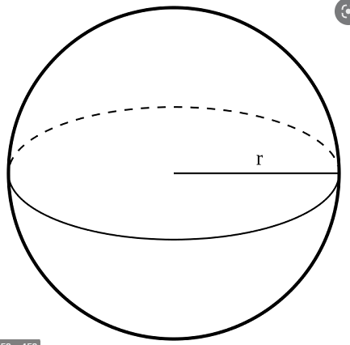





Area and Volume 2
Sphere
4
3
Volume of Sphere
$$π$$
$$=$$
$$×$$
r
3
$$=$$
$$π$$
2
Surface area of Sphere
4
r

Slide 6
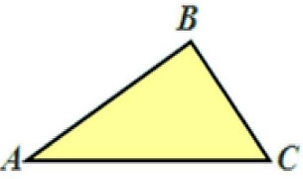
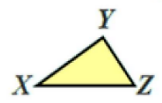











Area and Volume 3
If
$$∆ABC\sim ∆XYZ$$
$$∠A$$
$$=$$
$$∠X$$
$$=$$
$$∠Y$$
$$∠B$$
$$∠C$$
$$=$$
$$∠Z$$
And
AB
BC
CA
$$=$$
$$=$$
XY
YZ
ZX

Slide 7
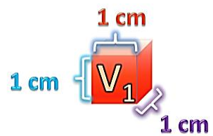
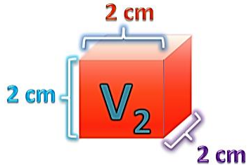




Similar Solid
L
2
A
1
Area ratio $:$
( )
$$=$$
1
L
A
2
2
L
3
V
1
Volume ratio $:$
( )
$$=$$
1
L
V
2
2

Slide 8
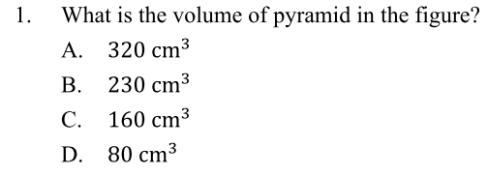
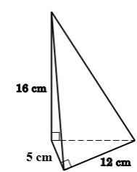

















Base area of pyramid
1
$$×$$
(
$$×$$
12
$$=$$
5 )
2
$$=$$
30
2
cm
Volume of Pyramid
1
$$=$$
$$×$$
Base area of pyramid
$$×$$
Height
3
1
$$=$$
$$×$$
30
$$×$$
16
3
$$=$$
160
3
cm
$$∴$$
3
The volume of pyramid is 160 . The answer is C.
cm

Slide 9
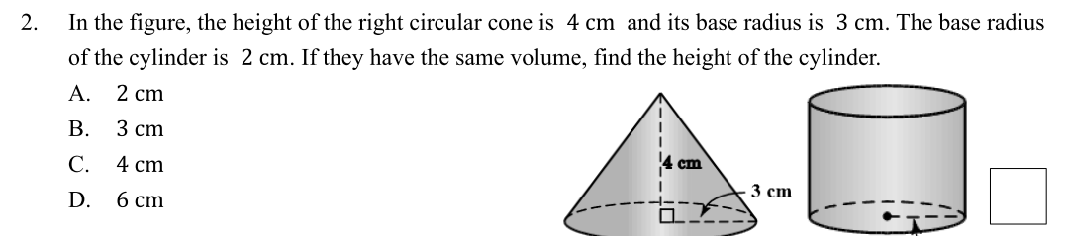
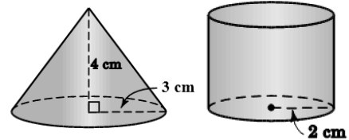


























































h cm
Base area of circular cone
Base area of cylinder
2
$$π$$
$$×$$
2
$$=$$
$$π$$
$$×$$
$$\text{r}$$
$$=$$
$$\text{p}$$
2
$$π$$
$$×$$
2
$$=$$
$$π$$
$$×$$
$$\text{3}$$
$$=$$
$$\text{2}$$
2
$$=$$
2
$$π$$
$$π$$
cm
$$=$$
$$\text{9}$$
cm
$$\text{4}$$
Volume of circular cone
Let h cm be the height of the cylinder.
1
$$=$$
Volume of circular cone
$$=$$
$$×$$
$$×$$
height
Volume of cylinder
Base area of cone
3
base area
$$=$$
$$π$$
$$×$$
$$\text{12}$$
height
1
$$=$$
$$×$$
$$\text{9}$$
$$π$$
$$×$$
4
$$×$$
$$π$$
$$=$$
$$π$$
3
h
$$\text{4}$$
$$\text{12}$$
$$=$$
$$π$$
3
h
$$=$$
$$\text{3}$$
cm
$$\text{12}$$
cm
$$∴$$
The height of cylinder is 3 . The answer is B.
cm

Slide 10
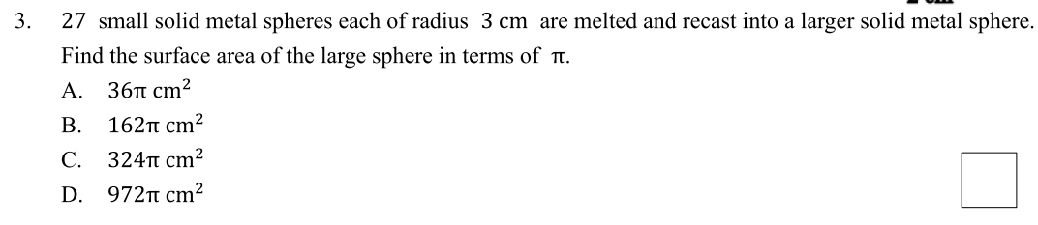




















































Total volume of the 27 small spheres
4
3
$$=$$
$$\text{27}$$
$$×$$
$$×$$
$$π$$
$$×$$
$$\text{r}$$
3
r
r
4
r
$$=$$
$$\text{27}$$
$$×$$
$$×$$
$$π$$
$$×$$
3
$$\text{3}$$
3
$$=$$
$$\text{972}$$
$$π$$
3
r
r
cm
Let p cm be the radius of large sphere.
$$∵$$
Volume of the large sphere
$$=$$
Total volume of the 27 small spheres
$$∴$$
4
3
$$×$$
$$π$$
$$×$$
$$\text{p}$$
$$=$$
$$\text{972}$$
$$π$$
p
3
3
$$=$$
$$\text{729}$$
$$\text{p}$$
$$\text{p}$$
$$=$$
$$\text{9}$$
cm
Surface area of large sphere
$$=$$
2
$$\text{4}$$
2
2
$$\text{4}$$
$$×$$
$$π$$
$$×$$
$$\text{p}$$
$$×$$
$$π$$
$$×$$
$$\text{9}$$
$$=$$
324$π$
$$=$$
cm
$$∴$$
2
The surface area of large sphere is 324 𝛑 . The answer is C.
cm

Slide 11
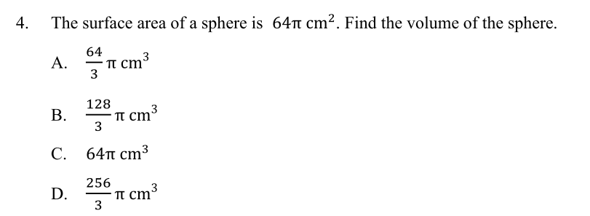








































r
Let r cm be the radius of the sphere.
Volume of the sphere
$$=$$
$$\text{4}$$
2
4
3
Surface area of the sphere
$$×$$
$$π$$
$$×$$
$$\text{r}$$
$$=$$
$$×$$
$$π$$
$$×$$
$$\text{r}$$
3
$$\text{64}$$
$$π$$
$$=$$
$$\text{4}$$
2
$$×$$
$$π$$
$$×$$
$$\text{r}$$
4
3
$$=$$
$$×$$
$$π$$
$$×$$
$$\text{4}$$
2
$$=$$
3
$$\text{r}$$
$$\text{16}$$
256
$$=$$
$$π$$
3
$$\text{r}$$
$$=$$
$$\text{4}$$
cm
cm
3
256
3
$$∴$$
$$π$$
The surface area of large sphere is . The answer is D.
cm
3

Slide 12
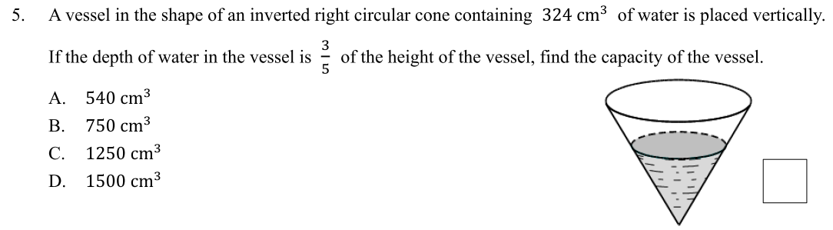
















3
Let x and h cm be the capacity and height of the vessel.
cm
$$∵$$
L
3
V
1
Volume ratio $:$
( )
$$=$$
1
L
V
2
2
height of the vessel
3
capacity of the vessel
$$∴$$
( )
$$=$$
depth of water
volume of water
h
3
x
(
)
$$=$$
3
324
h
h
5
depth of water
5
3
x
h
(
)
$$=$$
3
324
125
x
depth of water
$$=$$
27
324
3
x
$$=$$
1500
cm
$$∴$$
3
The surface area of large sphere is 1500 . The answer is D.
cm

Slide 13
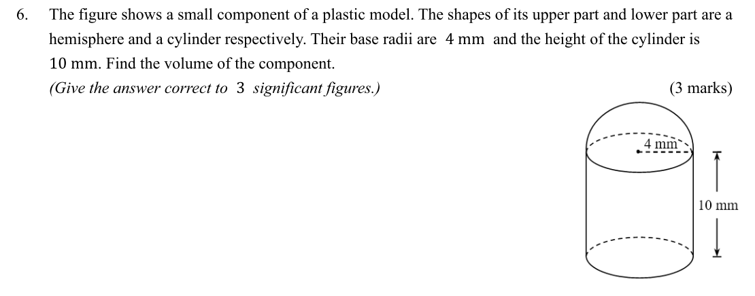

















































Volume of the hemisphere
Volume of the cylinder
1
4
3
$$×$$
Height
$$=$$
$$×$$
$$×$$
$$π$$
$$×$$
$$\text{r}$$
$$=$$
Base area
4mm
( )
2
3
$$=$$
2
$$π$$
$$×$$
$$\text{r}$$
Height
1
4
3
$$×$$
4mm
$$=$$
$$×$$
$$×$$
$$π$$
$$×$$
$$\text{4}$$
( )
2
3
2
$$=$$
$$π$$
$$×$$
$$\text{4}$$
$$×$$
10
1
4
10mm
$$=$$
$$×$$
$$×$$
$$π$$
$$×$$
$$\text{64}$$
2
3
$$=$$
160
$$π$$
3
cm
128
3
$$=$$
$$π$$
cm
3
Volume of the component
$$=$$
$$+$$
Volume of the hemisphere
Volume of the cylinder
128
3
$$=$$
$$π$$
$$+$$
160
$$π$$
$$=$$
637
cm
(correct to 3 sig. fig.)
3
$$∴$$
3
The volume of the component is 637 .
cm

Slide 14
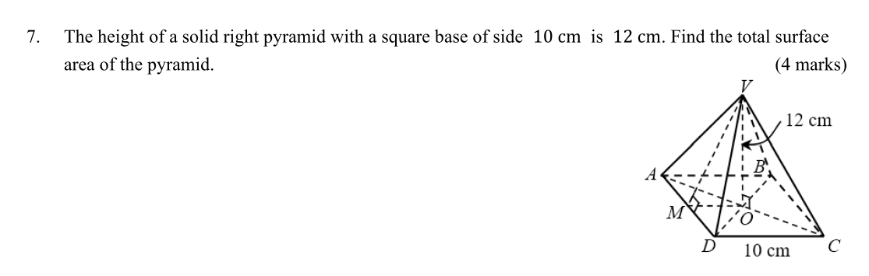






















































$$∵$$
The base of the right pyramid (ABCD) is a square.
V
V
$$∴$$
2
$$×$$
OM
$$=$$
CD
A
B
2
$$×$$
OM
$$=$$
10
OM
$$=$$
5
cm
M
O
D
D
C
A
M
In $∆VOM,$
2
2
Total surface area of pyramid ABCDV
OM
2
VO
$$=$$
VM
(Pyth. theorem)
$$+$$
$$+$$
$$+$$
$$=$$
Area of (square ABCD
$$∆VAD$$
$$∆VAB$$
2
2
2
$$\text{5}$$
$$+$$
$$\text{12}$$
$$=$$
VM
$$+$$
$$+$$
$$∆VBC$$
$$∆VCD$$
)
$$=$$
$$=$$
Area of (square ABCD
$$+$$
4
$$×$$
$$∆VAD$$
VM
25
$$+$$
144
)
$$=$$
1
VM
169
$$=$$
$$×$$
$$+$$
4
$$×$$
$$×$$
$$×$$
AD
CD
AD
VM
2
VM
$$=$$
13
cm
1
$$=$$
10
$$×$$
10
$$+$$
$$×$$
$$×$$
$$×$$
4
10
13
$$∵$$
ABCDV is a right pyramid.
2
$$=$$
360
2
cm
$$∴$$
$$∆VAD$$
$$=$$
$$∆VAB$$
$$=$$
$$∆VBC$$
$$=$$
$$∆VCD$$
$$∴$$
2
cm
The total surface area of pyramid is 360 .

Slide 15
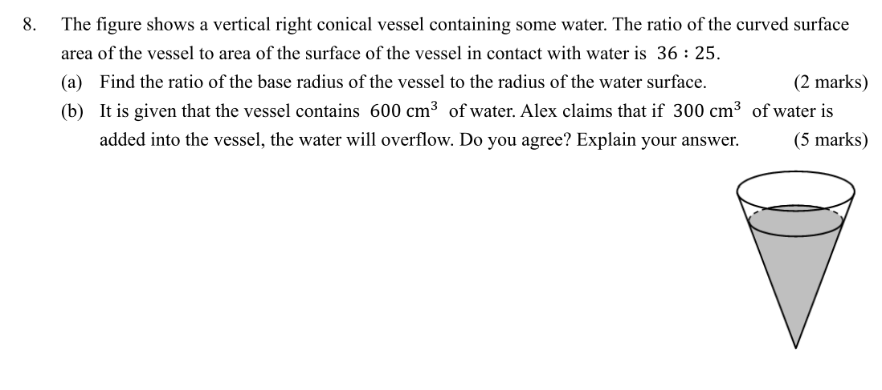














L
2
A
$$∵$$
1
1
Area ratio $:$
( )
$$=$$
L
A
2
2
$$∴$$
Base radius of vessel
2
Curved surface area of vessel
( )
$$=$$
Radius of water surface
Area of surface of vessel in contact with water
Base radius of vessel
2
36
( )
$$=$$
Radius of water surface
25
radius
Base radius of vessel
36
$$=$$
radius
Radius of water surface
25
Base radius of vessel
6
$$=$$
Radius of water surface
5
$$∴$$
The ratio of base radius of vessel to radius of water surface is 6 : 5 .

Slide 16








L
3
V
$$∵$$
1
Volume ratio $:$
( )
$$=$$
1
L
V
2
2
$$∴$$
Base radius of vessel
3
Volume of vessel
( )
$$=$$
Volume of water after addition
Radius of water surface
Volume of water
6
3
Volume of vessel
( )
$$=$$
5
600
$$=$$
600
$$+$$
300
216
Volume of vessel
$$=$$
$$=$$
900
3
125
600
cm
<
1036.8
3
Volume of vessel
$$=$$
1036.8
3
cm
cm
$$∴$$
The water will not overflow. Alex’s claim is not correct.

